Slide 1


Presenter Notes
A free resource from

Slide 2

Presenter Notes
Notes:
Copyright and licence notice
© 2016 Commonwealth of Australia and States and Territories of Australia
Ownership of intellectual property rights
Unless otherwise noted, copyright (and any other intellectual property rights, if any) in this publication is jointly owned by the Commonwealth, States and Territories of Australia.
Creative Commons Attribution 4.0 Licence
CC BY 4.0
All material in this publication is licensed under a Creative Commons Attribution 4.0 International Licence, save for logos. Attribution 4.0 International Licence is a standard form licence agreement. Under this licence: you may copy and redistribute the material in any medium or format and remix, transform and build upon the material. You must give appropriate credit, provide a link to the licence, and indicate if you have made any changes to the original work. You may do so in any reasonable manner, but not in any way that suggests the Commonwealth of Australia, States and Territories of Australia or Australian Building Codes Board endorses you or your use.
The full licence terms are available from https://creativecommons.org/licenses/by/4.0/legalcode.
Content contained herein should be attributed as:
The NCC Volume Two Energy Efficiency Group Exercises© as released by the Australian Building Codes Board Office on behalf of the Commonwealth of Australia and States and Territories of Australia
Disclaimer
While care has been taken in the preparation of this publication, the General Manager of the Australian Building Codes Board Office on behalf of the Commonwealth of Australia and States and Territories of Australia does not warrant that any licensing or registration requirements specified in this publication are either complete or up-to-date for your State or Territory. You can ensure that you are using the most up-to-date version by checking the Australian Building Codes Board website (www.abcb.gov.au).
The General Manager of the Australian Building Codes Board Office does not accept any liability, including liability for negligence, loss howsoever caused, damage, injury, expense or cost incurred by any person as a result of accessing, using or relying upon any information in this publication to the maximum extent permitted by law. No representation expressed or implied is made as to the currency, accuracy, reliability or completeness of any information or services which may appear on any linked websites, or other linked information sources.
The information is provided on the basis that all persons accessing the information contained in this publication undertake responsibility for assessing the relevance and accuracy of the information to their particular circumstances.
Published by: The Australian Building Codes Board
GPO Box 9839
CANBERRA ACT 2601
Phone: 1300 134 631 Email: ncc@abcb.gov.au
Website: www.abcb.gov.au
First published: August 2016
Print version: 1.0
Release date: August 2016

Slide 3
Presenter Notes
PowerPoint Resource
What is included:
Purpose
This PowerPoint is one of a suite of NCC Resource Kits. It is designed as a teaching resource to be used by teachers, industry associations and employers teaching others involved in energy efficiency building solutions of the NCC.
Slides with:
Teaching notes (Tell me more)
Examples (Tell me more)
Organised topics (Tell me more)

Slide 4

Presenter Notes
Presenter Notes
This PowerPoint Presentation contains only the group exercises developed for the Resource Kit.
Group Exercises
The presentation begins on the next slide …
Notes:
Quick Points:
To complete the following group exercises the following is required:
A copy of the NCC Volume Two.
Group Exercise – Glazing Calculator (Excel spread sheet) for use with Question Five of Exercise Two.
Computer access for all participants is desired, however the presenter can work through the glazing calculator on the main screen if need be.

Slide 5
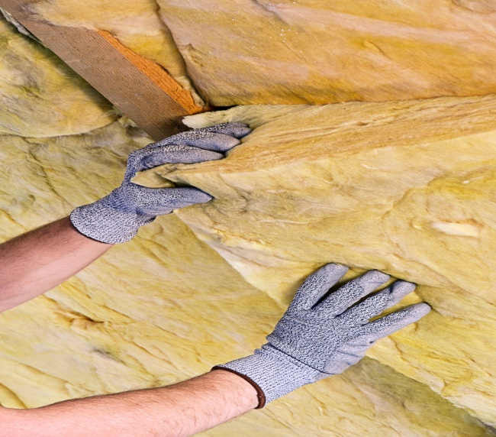

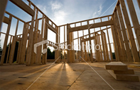


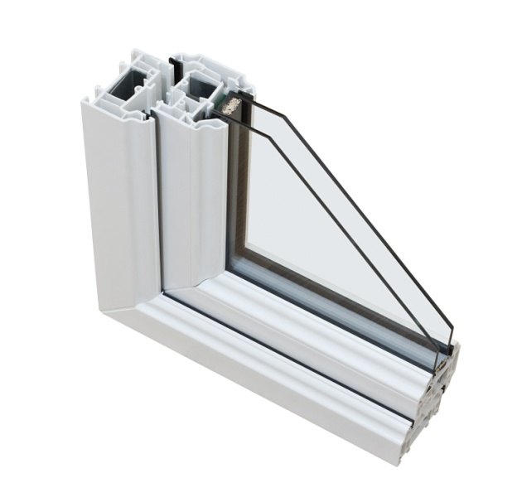

NCC Volume Two
Energy Efficiency
Group Exercises
What Practitioners Need to
Know

Slide 6
Table of Contents
Building Fabric
Glazing
Notes:
Quick Points:
The first topic for the group exercises will be ‘Building Fabric’.

Slide 7
Exercise 1 – Objective
The purpose of this exercise is to teach participants how to correctly interpret and apply the elemental energy efficiency Deemed-to-Satisfy Provisions for the fabric of houses.
To understand the principles behind these provisions, we will look at how the provisions relate to the roofs of houses.
Notes:
Exercise 1 - Objectives
Quick Points:
The purpose of the exercise is teach participants how to interpret the elemental energy efficiency provisions for the building fabric.
For this exercise we will be looking at the requirements for roofs of houses.
Background Notes:
Note: The ABCB NCC Volume Two Energy Efficiency Provisions Handbook, chapter eight might help with answering the questions and understanding the intent. In respect to the building fabric similar provisions apply for walls and floors.

Slide 8
Exercise 1 – Learning Outcomes
On completion of this exercise, participants should be able to–
Understand the meaning of R-Value.
Recognise the difference between R-Value and Total R-Value.
Identify those Deemed-to-Satisfy Provisions that prescribe minimum Total R-Values for building elements.
Identify the minimum Total R-Value for roofs in a given location.
Determine the Total R-Value of a particular form of roof construction.
Determine the amount of additional insulation required.
Consider how to choose insulation.
Consider installation requirements.
Notes:
Exercise 1 - Learning Outcomes
Quick Points:
Read the slide

Slide 9
Exercise 1
QUESTION 1:
In your own words, describe the meaning of R-Value or material R-Value?
ANSWER:
The degree to which a material resists the flow of heat.
A measure of a material's thickness divided by its thermal conductivity.
The higher the R-Value, the more the material resists the flow of heat.
Notes:
Exercise 1
Quick Points:
Read the slide.
To be taught as a group exercise, it may be best to provide all of these exercise questions on a single sheet for groups to consider before running through the answers on these PowerPoint slides. A question sheet is provided with the resource kit material.
A technical definition for R-Value can be found in Part 3.12 of NCC Volume Two.

Slide 10
Exercise 1
QUESTION 2:
In your own words, describe the difference between R-Value and Total R-Value?
ANSWER:
R-Value is the thermal resistance of a single material.
Total R-Value is the sum of the R-Values of all the components including air that make up a composite element such as a roof, wall or floor.
See example on next slide.
Notes:
Exercise 1
Quick Points:
Read the slide.
Technical definitions for these terms can be found in Part 1.1.1 of NCC Volume Two.

Slide 11
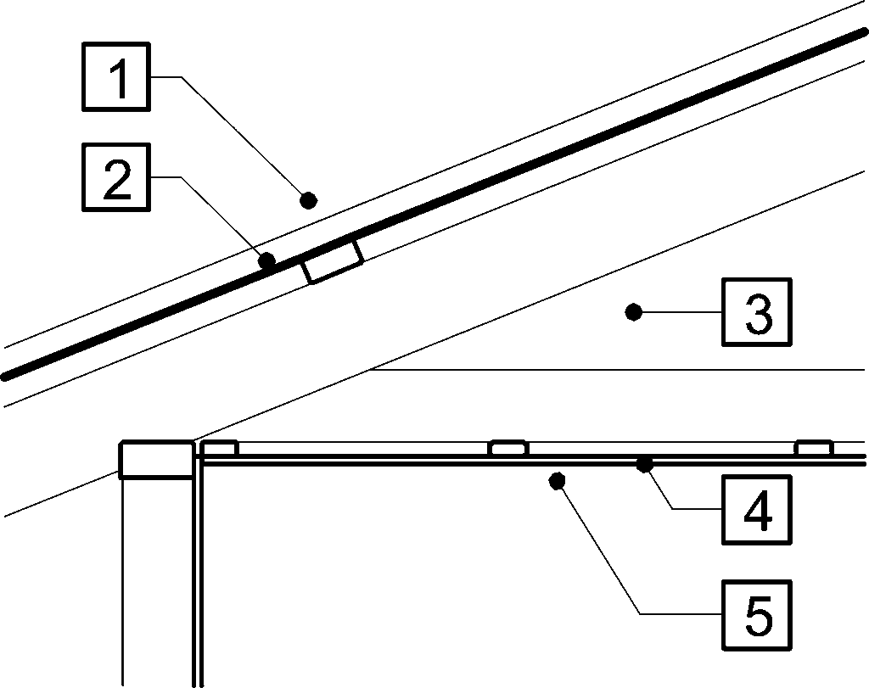
Exercise 1
QUESTION 2 ANSWER cont:
Roof construction description | Item | Item description | R-Value Unventilated |  | R-Value Ventilated
 |  |  | Up | Down | Up | Down
 | 1. | Outdoor air film (7m/s) | 0.04 | 0.04 | 0.04 | 0.04
 | 2. | Metal cladding | 0.00 | 0.00 | 0.00 | 0.00
 | 3. | Roof airspace (non-reflective) | 0.18 | 0.28 | 0.00 | 0.46
 | 4. | Plasterboard, gypsum (10 mm, 880 kg/m³) | 0.06 | 0.06 | 0.06 | 0.06
 | 5. | Indoor air film (still air) | 0.11 | 0.16 | 0.11 | 0.16
 | Total R-Value |  | 0.39 | 0.54 | 0.21 | 0.72
Notes:
Exercise 1
Quick Points:
This follows on from the answer from question 2.
You can see the individual elements R-Values which combine to a Total R-Value.

Slide 12
Exercise 1
QUESTION 3:
For what elements of a house, and in which clauses, do the NCC energy efficiency Deemed-to-Satisfy Provisions prescribe minimum Total R-Values?
ANSWER:
3.12.1.2 Roofs
3.12.1.4 External walls
3.12.1.5 Floors
Notes:
Exercise 1
Quick Points:
Read the slide.
Background Notes:
Note: For the purpose of 3.12.1.2, a roof also incorporates a ceiling.

Slide 13
Exercise 1
QUESTION 4:
What is the minimum Total R-Value that a roof and ceiling in climate zone 1 is required to achieve?
ANSWERS:
R3.1 downwards if a very light colour (solar absorptance no more than 0.4)
R4.1 downwards if a medium colour (solar absorptance between 0.4 & 0.6)
R5.1 downwards if a dark colour (solar absorptance more than 0.6)
Note: The colour is only indicative of the solar absorption. See manufacturer’s data for solar absorptance values.
Notes:
Exercise 1
Quick Points:
Read the slide.
This answer can be found in Table 3.12.1.1a of NCC Volume Two.
Note: where there are penetrations in the ceiling insulation, the lost insulation must be adjusted for using 3.12.1.1(e) of NCC Volume Two.
Background Notes:
Note the direction in which the R-Value is to be measured (i.e. downwards). This direction relates to the predominant direction of heat flow for the particular climate zone. In this case, because climate zone 1 is a hot climate it is important to reduce summertime heat gain through the roof and hence, slow down the passage of heat in the downward direction through the roof. In a cooler climate zone (ie climate zone 7) it is important to be able to retain heat in winter and hence slow down the passage of heat in the upward direction through the roof.

Slide 14
Exercise 1
QUESTION 5:
What is the minimum Total R-Value required for a roof with a flat ceiling in climate zone 2 (below 300 m altitude) and a roof solar absorptance of 0.55?
ANSWER:
R4.6 downwards; or
R4.1 downwards if the roof space is also ventilated and has the required insulation laid on the ceiling.
Notes:
Exercise 1
Quick Points:
Read the slide.
These values can be found in Part 3.12.1.2(b) and Table 3.12.1.1a of NCC Volume Two.
Note: where there are penetrations in the ceiling insulation, the lost insulation must be adjusted for using 3.12.1.1(e) of NCC Volume Two.
Background Notes:
Note that there are three grades of roof colour and bare galvanising is 0.55 solar absorptance. The Explanatory Information in Volume Two provides guidance as to the solar absorptance of colours. Note also that for a roof to be considered ventilated, there is specific criteria detailed in Volume Two, i.e. the minimum number, size and location of vents or ventilators is prescribed.

Slide 15
Exercise 1
QUESTION 6:
What is the inherent Total R-Value of an un-insulated pitched metal roof with a flat ceiling in climate zone 2 (below 300 m altitude), and in climate zone 6?
ANSWER:
In climate zone 2 (below 300m altitude), R0.54 downwards if the roof space is unventilated or R0.72 downwards if the roof space is ventilated.
In climate zone 6, R0.39 upwards if the roof space is unventilated or R0.21 upwards if the roof space is ventilated.
Notes:
Exercise 1
Quick Points:
Read the slide.
These numbers can be found in Figure 3.12.1.1(d) of NCC Volume Two.
Note the reference to the direction of heat flow for different climate zones (ie upwards/downwards) which can be found in Table 3.12.1.1a of NCC Volume Two.
Note: where there are penetrations in the ceiling insulation, the lost insulation must be adjusted for using 3.12.1.1(e) of NCC Volume Two.

Slide 16
Exercise 1
QUESTION 7:
How much insulation is required to be added to a pitched dark tiled roof with a flat ceiling in climate zone 6?
ANSWER:
R4.87 upwards (R5.1-R0.23) if ventilated,
R4.69 (R5.1-R0.41) if not ventilated.
Notes:
Exercise 1
Quick Points:
Read the slide.
Note: where there are penetrations in the ceiling insulation, the lost insulation must be adjusted for using 3.12.1.1(e) of NCC Volume Two.
Background Notes:
Answer can be found by using Table 3.12.1.1a, associated explanatory information and Figure 3.12.1.1(c) in NCC Volume Two.
The solar absorptance is assumed to be greater than 0.6 (for a dark roof).

Slide 17
Exercise 1
QUESTION 8:
How much insulation is required to be added to a pitched metal roof with a flat ceiling and ventilated roof space in climate zone 2 (below 300 m altitude)?
ANSWER:
R3.38 (R4.1-R0.72) downwards if a very light colour (no more than 0.4)
R3.88 (R4.6-R0.72) downwards if a medium colour (0.4 to 0.6)
R4.38 (R5.1-R0.72) downwards if a dark colour (more than 0.6)
Note: The colour is only indicative of the solar absorption. See manufacturer’s data for solar absorptance values.
Notes:
Exercise 1
Quick Points:
Read the slide.
Note that the required insulation is placed on the ceiling and the roof space is ventilated.
Note: where there are penetrations in the ceiling insulation, the lost insulation must be adjusted for using 3.12.1.1(e) of NCC Volume Two.
Background Notes:
Answer can be found by using Table 3.12.1.1a and Figure 3.12.1.1(d) of NCC Volume Two.

Slide 18
Exercise 1
QUESTION 9:
What needs to be considered when selecting insulation?
ANSWER:
Whether its R-Value has been determined in accordance with AS/NZS 4859.1.
Whether it achieves the required R-Value in the specified direction of heat flow.
Location of the insulation, i.e. under the roof or on the ceiling.
Notes:
Exercise 1
Quick Points:
Read the slide.
Background Notes:
It is important to check the labelling of insulation. In the first instance, it is important that the R-Value attributed to the insulation has been determined in accordance with AS/NZS 4859.1. In the second instance, it is important to ensure that the insulation achieves the required R-Value in the required direction.
Note – if the required minimum added R-Value cannot be achieved with one product, two types of insulation can be used and their R-Values combined to achieve the required value. For example, bulk insulation can be installed above the ceiling and reflective insulation installed below the roof in order to achieve the required minimum added R-Value. Consideration should also be made to the weight of the insulation on a ceiling and condensation issues.

Slide 19
Exercise 1
QUESTION 10:
What needs to be considered when installing insulation?
ANSWER:
Insulation must–
abut or overlap adjoining insulation except where there are framing members.
create a continues barrier with other elements.
not affect the safe operation of fans, lights, fittings, etc.
for bulk insulation, maintain its position & thickness.
be located to suit the climate zone.
Notes:
Exercise 1
Quick Points:
Read the slide.
More detail on these requirements can be found in Part 3.12.1.1 of NCC Volume Two.
Background Notes:
Note: It is critical that bulk insulation maintains its position and thickness if it is to perform as intended. Compressing bulk insulation reduces its R-Value.

Slide 20
Exercise 1
QUESTION 11:
What also needs to be considered when installing reflective insulation?
ANSWER:
Reflective insulation must–
have an adjoining airspace.
be adequately supported by framing members.
be overlapped or taped.
Notes:
Exercise 1
Quick Points:
Read the slide.
Background Notes:
Note: The R-Value achieved with reflective insulation is dependent upon the adjoining airspace. Installers should refer to the manufacturers instructions to ensure that the correct airspace is achieved.

Slide 21
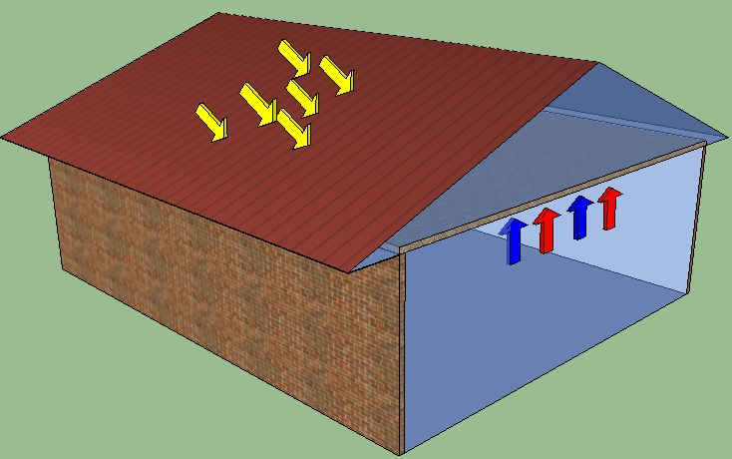
Worked Example
Notes:
Worked Example
Quick Points:
Lets consider the requirements of a standard roof design.
For example:
Minimum require Total R-Value for the roof.
The R-Value of the uninsulated roof construction (i.e. the thermal performance of the construction components).
The adjusted minimum R-Value for loss of ceiling insulation.

Slide 22
Simple Checklist
Climate Zone
Minimum Total R-Value Requirement
Direction of Heat Flow
Roof Space Ventilation
Roof Solar Absorptance
Adjustment for loss of Insulation (penetrations)
Typical R-Values of
Roof and Ceiling Construction
Notes:
Simple Checklist
Quick Points:
Read the slide.
You can use the check list to assist you.

Slide 23
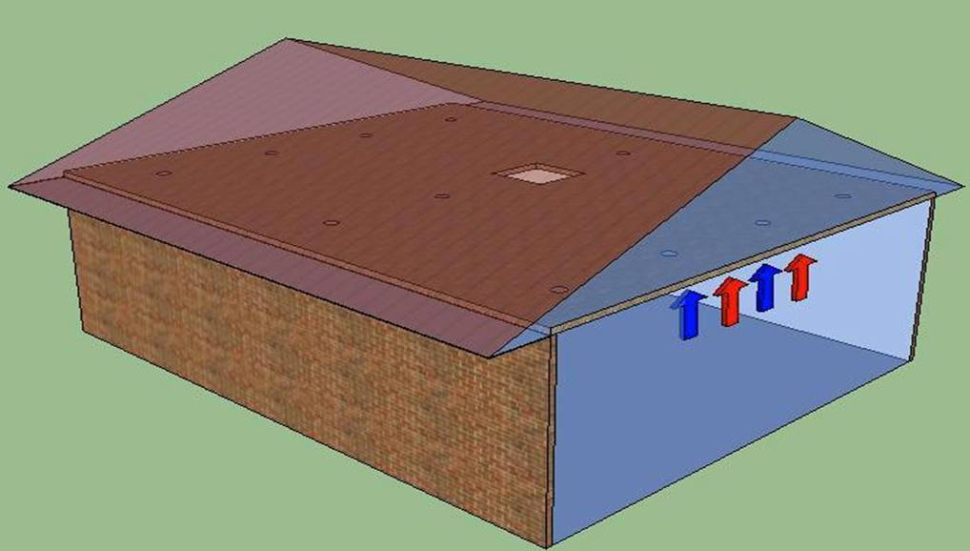
Group Activity
Key stats
Climate Zone 3
Direction of heat flow downwards & upwards
Red roof – Solar absorptance 0.75
Non-Ventilated metal roof
1 service opening in insulation = 1 m²
11 lighting openings in insulation for lights
Assume each light is 100 mm in diameter
Floor area = 100m²
Notes:
Group Activity
Quick Points:
Key statistics include the following:
Climate Zone 3.
Direction of heat flow downward and upwards (Table 3.12.1.1a)
Red roof – Solar absorptance 0.75.
Non-Ventilated metal roof.
1 service opening in insulation = 1 m².
11 lighting openings in insulation at minimum clearance for halogen lamp.
Assume each light is 100 mm in diameter
Floor area = 100m²
Background Notes:
In reality a standard down light will not be 100 mm in diameter, however for the purpose of the this exercise the 100 mm will assist in calculating the requirements.
Direction of heat flow – for climate zone 3, both downward and upward direction of heat flow needs to be considered. The combined downward and upwards requirement means that summer and winter (heating and cooling) have a roughly similar level of impact on an annual basis, while an upward flow indicates that heat loss from the building during winter is a major concern.
For the purpose of the group activity concentrate on the upwards heat flow, as this is the more stringent requirement. Therefore if the upward heat flow requirements are met, the downward heat flow requirements will also be achieved.

Slide 24
Group Activity
NCC & Standards
Minimum Total R-Value
Table 3.12.1.1a
Compensation of Insulation
Table 3.12.1.1b
Insulation Clearance
AS/NZS 3000 –
Figure 4.7
Typical Construction
Figure 3.12.1.1
Notes:
Group Activity NCC & Standards
Quick Points:
The relevant tables and figures in 3.12.1.2 of NCC Volume Two for this group activity include:
The Minimum Total R-Value Table – Table 3.12.1.1a
The Compensation of Insulation Table – Table 3.12.1.1b
Typical Construction Figure – Figure 3.12.1.1 and
The insulation clearance requirements from AS/NZS 3000.
The relevant NCC Volume Two parts are shown on the following slides.

Slide 25
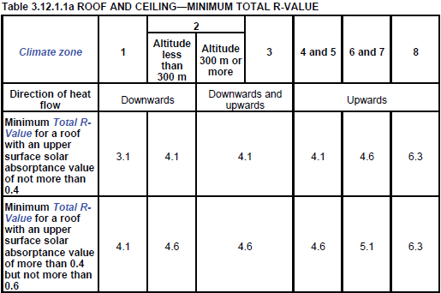
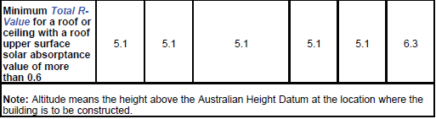
Minimum Total R-Value Table 3.12.1.1a
Notes:
Minimum Total R-Value (Table 3.12.1.1a)

Slide 26
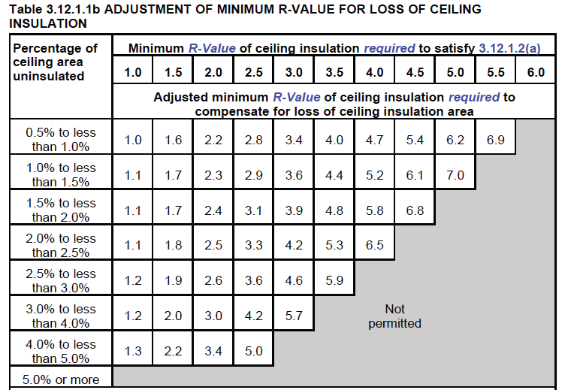
Compensation of Insulation Table 3.12.1.1b
Notes:
Compensation of Insulation (Table 3.12.1.1b)

Slide 27
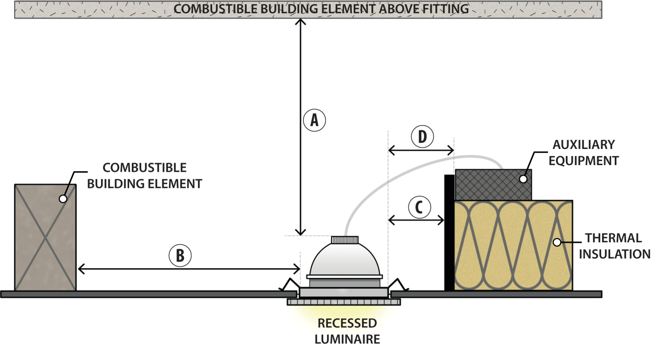
Insulation clearances
AS/NZS 3000
A = 200 mm
B = 200 mm
C = 50 mm
D = 50 mm
Notes:
Insulation clearances AS/NZS 3000
Quick Points:
AS/NZS 3000 provides requirements for the distance insulation should be kept away from downlights.
The Standard refers to the light manufactures specifications or default values.
The default values are as follows:
A – Clearance above the recessed luminaire – 200 mm.
B – Clearance to the side of the recessed luminaire to combustible building element – 200 mm.
C – Clearance to the side of the recessed luminaire to bulk insulation – 50 mm.
D – Clearance to any auxiliary equipment (This would include the transformer for the luminaire) – 50 mm.
Background Notes:
The values in the table are worst-case values. Smaller clearances can be used if they are supported by the manufacturer’s product information

Slide 28
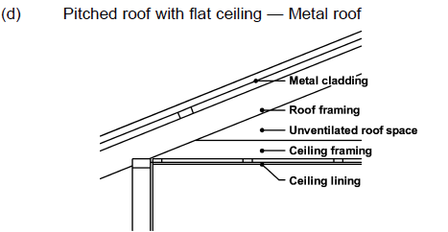
Typical Construction
Figure 3.12.1.1
Figure 3.12.1.1 TOTAL R-VALUE FOR TYPICAL ROOF AND CEILING CONSTRUCTION
Roof construction detail |  | Total R-Value
 | Ventilated | Up | 0.72
 |  | Down | 0.21
 | Unventilated | Up | 0.54
 |  | Down | 0.39
Notes:
Typical Construction (Figure 3.12.1.1)
Quick Points:
The attached image is an extract out of the NCC.
It shows the typical R-Value for a Pitched metal roof with a flat ceiling.
Background Notes:
Figure 3.12.1.1 presents Total R-Values (without insulation) for different forms of roof and ceiling construction with and without a ventilated ceiling and with “up” and “down” heat flow direction

Slide 29
Group Activity
QUESTION 12:
What is the uninsulated R-Value of the roof and the minimum added insulation required?
ANSWER:
Uninsulated roof construct R 0.54 (downward) & R 0.39 (upward)
Minimum added insulation in the downward direction R 4.56 (Minimum total R-Value required 5.1 minus uninsulated roof construct R-Value of 0.54)
Minimum added insulation in the upward direction R 4.71 (Minimum total R-Value required 5.1 minus uninsulated roof construct R-Value of 0.39)
Notes:
Group Activity
Quick Points:
Answers
Minimum require Total R-Value for the roof: R 5.1. (Table 3.12.1.1a – climate zone 3, solar absorptance more than 0.6, downward and upward direction of heat flow))
Uninsulated roof construct R-Value: R 0.54 Down and R 0.39 Up. (Figure 3.12.1.1(d) – pitched roof, flat ceiling, metal roof, unventilated, downward and upward direction of heat flow)
Minimum required insulation:
for downward direction is R 4.56 (R5.1 – R0.54)
for upward direction is R 4.71 (R5.1 – R0.39)

Slide 30
Group Activity
QUESTION 13:
What is the percentage of insulation lost from the service opening and light installations?
ANSWER:
1.341% of the 100m² floor area
Notes:
Group Activity
Quick Points:
Answers
Assume the insulation loss around the halogens is a circle with a radius of 100 mm (50 mm for insulation, 50 mm for light fitting = 100mm or 0.1m).
Therefore each opening is a loss of $πr^{2}$ = 3.141 x 0.1² = 0.031 m².
Therefore the loss from 11 halogens is = 0.031 x 11 = 0.341 m².
The loss from the service installation is 1 m².
Therefore total loss is (0.341m² + 1m²) = 1.341 m² (which is 1.341 % of the 100 m² floor area).

Slide 31
Group Activity
QUESTION 14:
What is the adjusted minimum R-Value of ceiling insulation required to compensate for the loss of ceiling insulation?
ANSWER:
Adjusted minimum R-Value is 6.2 in the downward direction
Adjusted minimum R-Value is 6.5 in the upward direction
Notes:
Group Activity
Quick Points:
Answers
The total loss from Q13 is 1.341%, meaning the adjusted minimum R-Value is between 6.1 and 7.0 (Table 3.12.1.1b - 1.0% to less than 1.5%).
Using linear interpolation the required adjusted minimum R-Value is
6.208 (i.e. R-value 6.2) in the downward direction,
6.478 (i.e. R-value 6.5) in the upward direction.

Slide 32
Table of Contents
Building Fabric
Glazing
Notes:
Quick Points:
The next topic for the group exercises will be ‘Glazing’.

Slide 33
Exercise 2 – Objective
The purpose of this exercise is to teach participants how to correctly interpret and apply the elemental energy efficiency Deemed-to-Satisfy Provisions for the external glazing of houses.
Notes:
Exercise 2 - Objectives
Quick Points:
The purpose of this exercise is to teach participants how to correctly interpret and apply the elemental energy efficiency Deemed-to-Satisfy Provisions for the external glazing of houses.

Slide 34
Exercise 2 – Learning Outcomes
On completion of this exercise, participants should:
Appreciate the importance of glazing to the thermal performance of a house.
Understand the meaning of external glazing.
Understand the meaning of Total System U-Value.
Understand the meaning of Total System Solar Heat Gain Coefficient (SHGC).
Understand the basic principles of the glazing formulae in the elemental Deemed-to-Satisfy Provisions.
Know how to use the ABCB's glazing calculator.
Notes:
Exercise 2 - Learning Outcomes
Quick Points:
The following points detail the specific areas that will be taught during this exercise:
Appreciate the importance of glazing to the thermal performance of a house.
Understand the meaning of external glazing.
Understand the meaning of Total System U-Value.
Understand the meaning of Total System Solar Heat Gain Coefficient (SHGC).
Understand the basic principles of the glazing formulae in the elemental Deemed-to-Satisfy Provisions.
Know how to use the ABCB's glazing calculator.

Slide 35
Exercise 2
QUESTION 1:
In your own words, what constitutes the external glazing of a house?
ANSWER:
External glazing includes windows and glazed doors.
It excludes roof lights and opaque panels.
Glazing includes both the glass and frame.
Notes:
Exercise 2
Quick Points:
Read the slide.
A formal definition for glazing can be found in Part 1.1.1 of NCC Volume Two.
Background Notes:
It is particularly important to note that glazing includes both the glass and frame. This is because the frame can have a significant effect on the thermal performance of a window or glazed door.

Slide 36
Exercise 2
QUESTION 2:
In your own words, describe the meaning of Total System U-Value?
ANSWER:
The degree to which a material allows heat to conduct through it.
The Total System U-Value of glazing includes the glass, frame, airspace (for double glazing) and surface resistances.
The higher the Total System U-Value the more easily a material allows heat to pass through.
Notes:
Exercise 2
Quick Points:
Read the slide.
A formal definition of Total System U-Value can be found in Part 1.1.1 of NCC Volume Two.
Background Notes:
It is particularly important to note that the Total System U-Value of glazing covers both the glass and frame. This is because the frame can have a significant effect on the Total System U-Value of a window or glazed door.

Slide 37
Exercise 2
QUESTION 3:
In your own words, describe the meaning of Total System Solar Heat Gain Coefficient (SHGC)?
ANSWER:
The percentage of solar radiation that passes through the glazing.
The SHGC of glazing includes the glass and frame.
The higher the SHGC the greater amount of solar radiation that passes through the glazing.
Notes:
Exercise 2
Quick Points:
Read the slide.
A formal definition of Total System SHGC can be found in Part 1.1.1 of NCC Volume Two.
Background Notes:
Again, it is important to note that the SHGC of glazing covers both the glass and frame.

Slide 38
Exercise 2
QUESTION 4:
Using 3.12.2.1(a), determine whether the external glazing for the house described below is compliant.
House is located in climate zone 5.
Single storey concrete slab-on-ground floor.
100 m² rectangular floor plan, long axis east - west.
300 mm eaves on all sides
Window head height 100 mm below the eaves.
Standard ventilation.
Single glazed clear aluminum windows
(Total System U-Value of 7.9 W/m².K and SHGC of 0.81).
See plan and glazing schedule on next slide
Notes:
Exercise 2
Quick Points:
Read the slide.

Slide 39

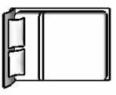
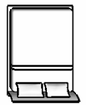





Exercise 2
True North
G1
G2
G3
G4
600
BED 1
BED 2
GLAZING SCHEDULE
G1 | 1800h x 2400w Sliding Window
G2 | 1200h x 2400w Sliding Window
G3 | 1800h x 2400w Sliding Window
G4 | 1800h x 2400w Sliding Window
G5 | 2100h x 2400 w Sliding Door
G6 | 1800h x 2400w Sliding Window
G7 | 1800h x 2400w Sliding Window
G8 | 1800h x 2400w Sliding Window
8000
9200
STUDY
DINING
LIVING
KITCHEN
G8
G7
G6
G5
600
600
12500
600
13700
Notes:
Exercise 2
Quick Points:
This image will assist you to determine if the design complies.
Working time.
Alternatively the glazing calculator could be used.
The glazing calculator for the group exercise has been included in the training package.

Slide 40
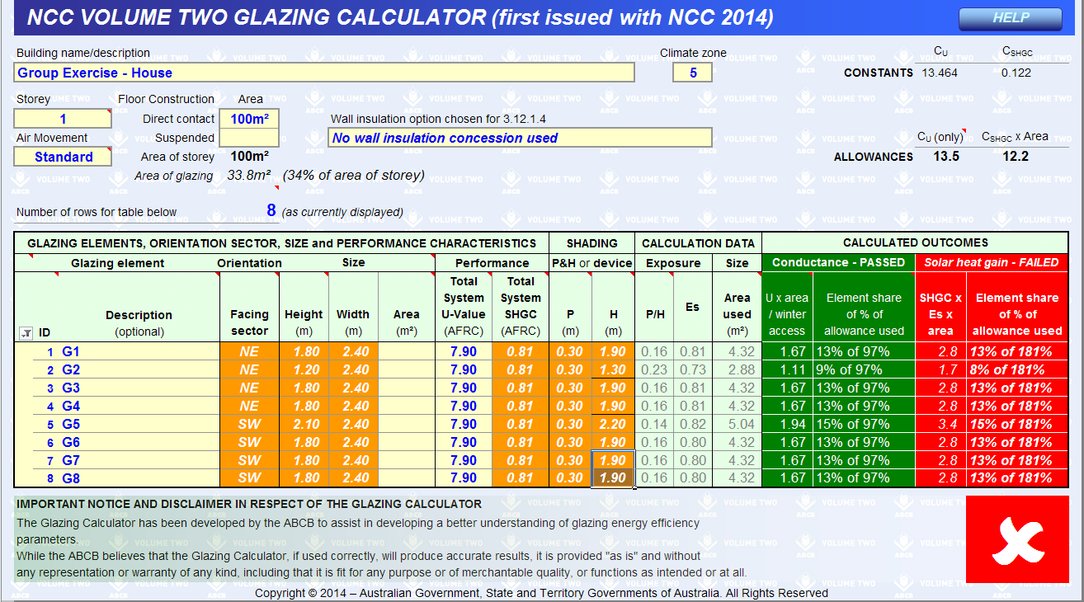
Exercise 2
Notes:
Exercise 2
Quick Points:
The glazing calculator confirms that the glazing does not comply for solar heat gain.

Slide 41
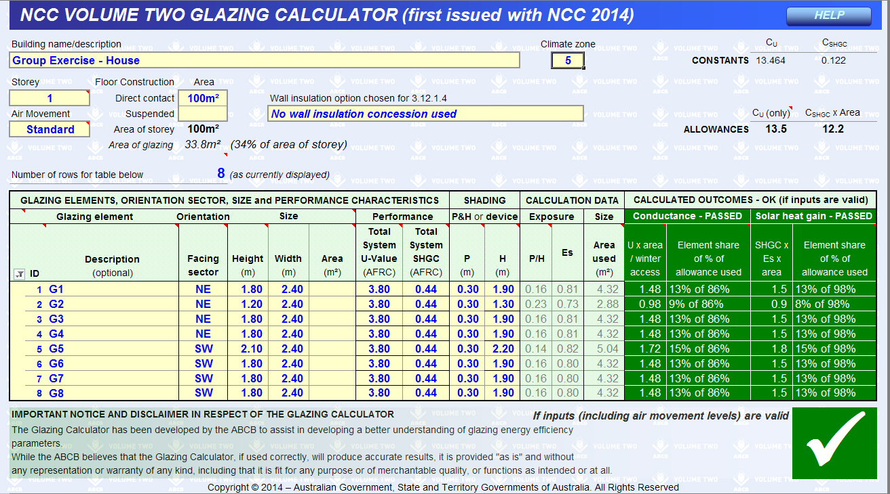
Exercise 2
Notes:
Exercise 2
Quick Points:
One method to achieve compliance would be to change the glazing from standard to tinted and coated (improve glazing performance).
Background Notes:
Note: A building in climate zone 5 has both cooling and heating needs and changing glazing types can improve one aspect to the detriment of the other.

Slide 42



Australian Building Codes Board
www.abcb.gov.au
Notes:
Australian Building Codes Board
Quick Points:
16 ABCB Board members
The ABCB Office is based in Canberra.
Hosted by the Department of Industry, Innovation and Science.
Main role of ABCB is to develop and maintain the NCC.
Background Notes:
The ABCB Board consists of sixteen members including a Chair, the head of each Commonwealth, State and Territory Administration responsible for building matters, up to five industry representatives, and a representative of the Australian Local Government Association.
The ABCB Office is based in Canberra and is hosted by the Commonwealth Department of Industry, Innovation and Science (which provides the Secretariat for the Building Ministers’ Forum which consists of the nine Ministers with building and plumbing responsibilities).
For information about the ABCB, the NCC or any supporting materials visit www.abcb.gov.au

Slide 43
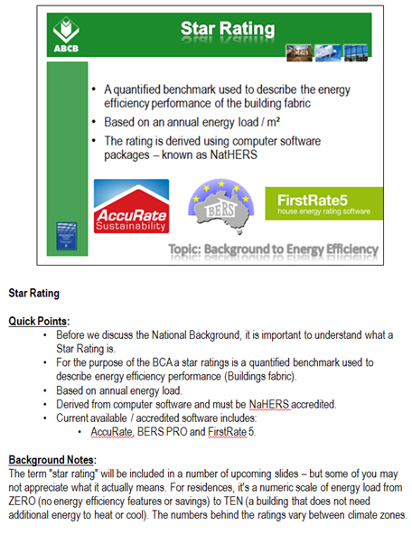
Teaching Notes
Teaching Notes
Example:
Each slide has teaching notes that include Background Notes on the topic of the slide, along with the key points; referred to as Quick Points.
You can print out the teaching notes by:
File / Print
Under Setting change to Notes Page

Slide 44
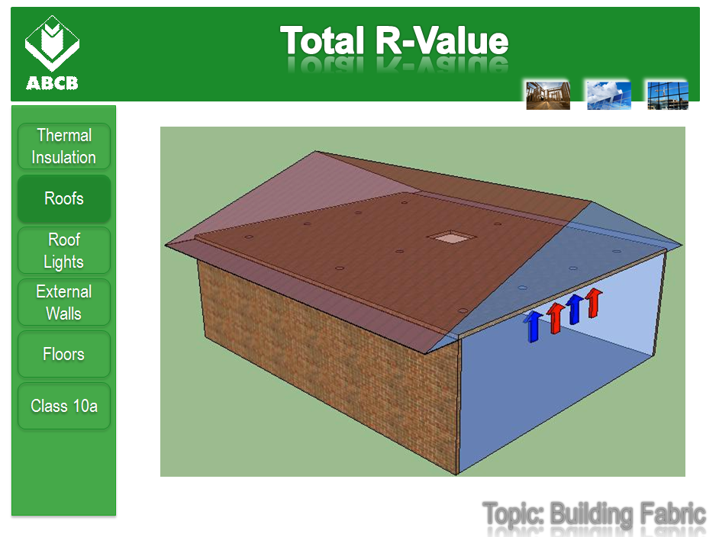
Use of Examples
Use of Examples
Best used with a copy of the NCC in hand …
A number of examples have been presented within this resource. They are for teaching purposes only and have been simplified in some instances. However, they do show how the NCC is applied in different instances.

Slide 45
Group Exercises Presentation
Focus of Content
What’s presented
This presentation only includes group exercises and questions. It does not include any other content that is contained within the rest of the module. Therefore it important that the group this is presented to, either have a good understanding of the NCC or have already seen the contents of this module.
Group Exercises and Questions
What it does not cover
General contents of the Module
Notes:
45

Slide 46
All Slides Presentation
Focus of Content
What’s presented
There are approximately 150 content slides in this presentation, so you may need to decide which topics are important to your group.
Remember that the Table of Contents (without any highlights) can link you to any section in the PowerPoint. Therefore, if you are running out of time and want to skip a topic, just click another topic.
All of the content from the main topics
What it does not cover
Additional Group Exercises
Notes:
46

